Slide 1
Forensic Investigation of Echo Show Device

Slide 2
Overview of Labs

Slide 3
# | Lab | Topic Covered | No. of Slides
1 | Lab 0 | Introduction of Echo Show 8 (2nd Generation) Device | 13
2 | Lab 1 | Evidence Planting | 13
3 | Lab 2 | Device Teardown and eMMC Chip-off | 25
4 | Lab 3 | Image Acquisition and Mounting | 17
5 | Lab 4.1.1 | Specifications: Device and OS Info | 15
6 | Lab 4.1.2 | Specifications: User Info | 30
7 | Lab 4.1.3 | Specifications: Network Connectivity Info | 13
8 | Lab 4.2.1 | Web Activity | 13
9 | Lab 4.2.2 | Phone Calls | 16
10 | Lab 4.3.1 | Multimedia: Photos and related Data | 21
11 | Lab 4.3.2 | Multimedia: Videos and related Data | 16
12 | Lab 4.3.3 | Multimedia: Audio and related Data | 39

Slide 4
Introduction

Slide 5
IoT Forensics
Definition: It is the process of collecting, analyzing, and preserving digital evidence from Internet of Things (IoT) devices for investigative purposes
It is crucial for investigating cybercrimes, security incidents, accidents, or any other events involving IoT devices.
It unveils user traces, interactions, and data for digital forensics investigations.

Slide 6
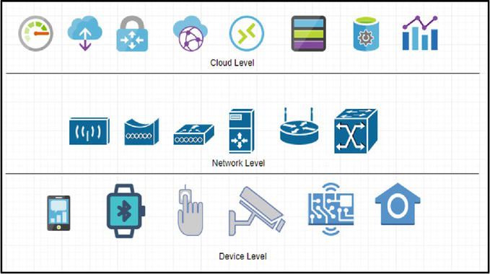
Levels of Investigation in IoT forensics
Collect data from cloud; most dificult; all possible data resides on cloud
Collect data from netwroks logs; helps inestigate netwrok traffic and identify attackers (if any)
Collect data from local memory of device; limited data due to storage limitation
Source: A Review on the Internet of Things (IoT) Forensics: Challenges, Techniques, and Evaluation of Digital Forensic Tools

Slide 7
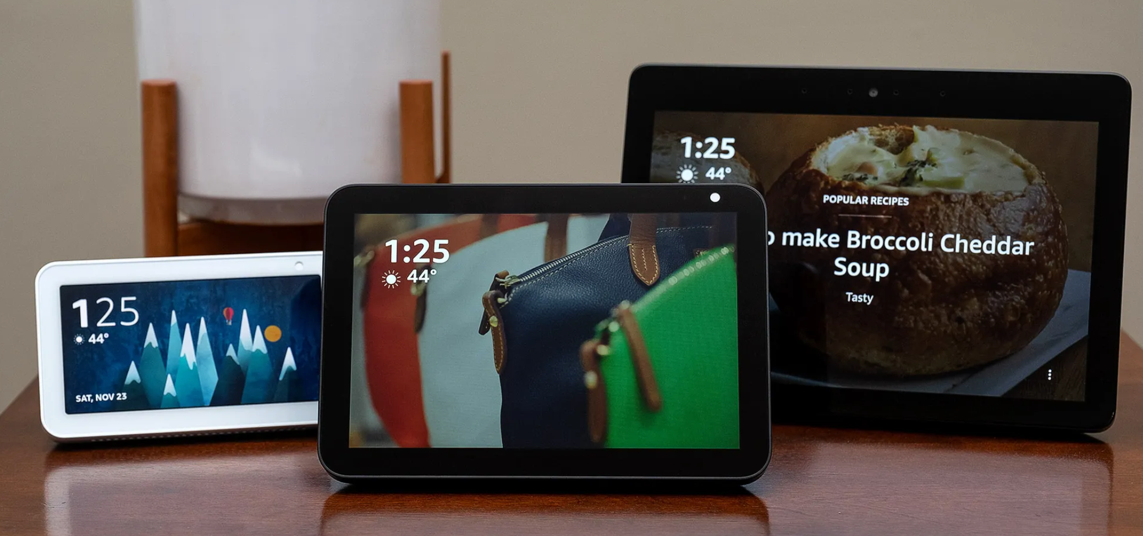
Echo Show Device: An IoT Device by Amazon
Definition: A smart display device, part of their Echo product line.
Features: Voice-activated technology coupled with a user-friendly touchscreen interface.
Significance: IoT devices, like the Echo Show, are integral to our interconnected world
Image Source: The best smart displays for 2021 - The Verge

Slide 8
Echo Device Models & Specifications
Model | Display Size | Internal Storage | RAM | Processor | Release Date
Echo Show (1st Gen) | 7-inch | 8GB eMMC | 1GB | Intel Atom x5-Z8350 | June 2017
Echo Show (2nd Gen) | 10-inch | 8GB eMMC | 2GB | MediaTek MT 8163 | Oct 2018
Echo Show 5 | 5.5-inch | 8GB eMMC | 1GB | MediaTek MT 8163 | June 2019
Echo Show 8 | 8-inch | 8GB eMMC | 2GB | MediaTek MT 8163 | Nov 2019
Echo Show 10 (3rd Gen) | 10.1-inch | 16GB eMMC | 3GB | MediaTek 8183 | Feb 2021
Echo Show 15 | 15.6-inch | 16GB eMMC | 3GB | Amlogic Pop1 | Late 2021

Slide 9
Device Level Forensic Investigation of Echo Show 8
Device Investigated: Echo Device 8 (2nd Gen.)
Purpose: Explore device activity and conduct data recovery.
Objective: Extract the planted evidence from the device.

Slide 10
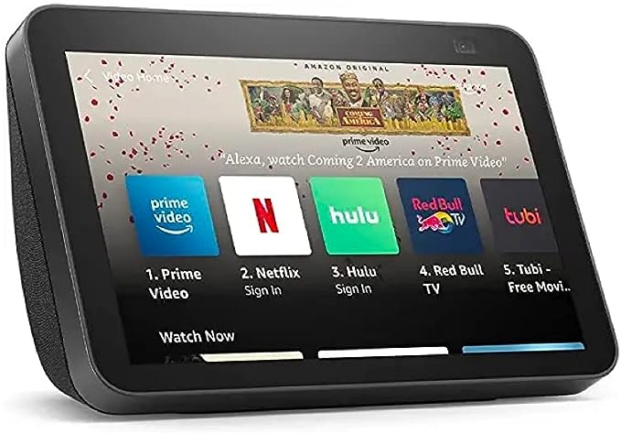
Echo Device 8 (2nd Gen.) Specifications
Display Size | 8-inch
Internal Storage | 8GB eMMC
RAM | 2GB
Processor | MediaTek MT 8163
OS | Fire OS (Android-based)
Release Date | November 2019
Image Source: Echo Show 8 (2nd Gen) (amazon.com)

Slide 11
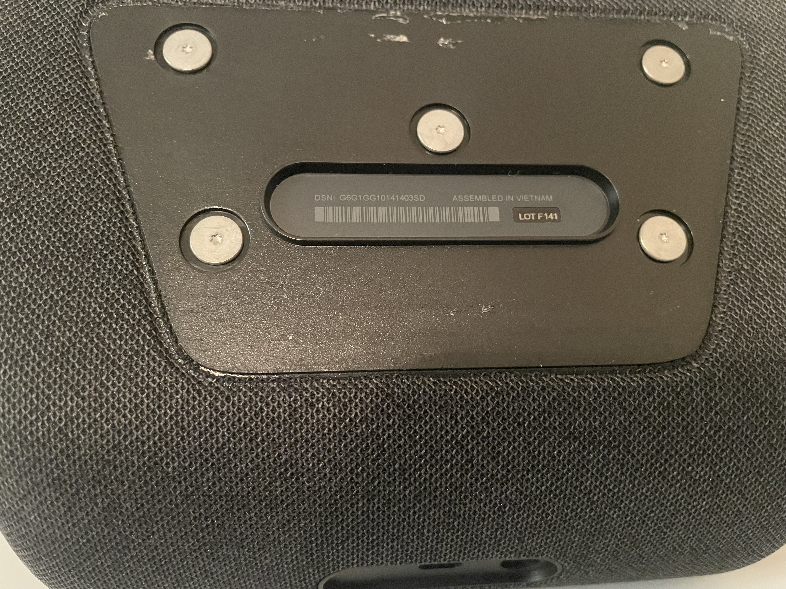
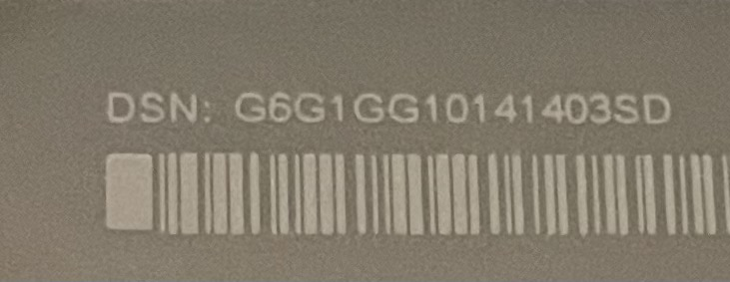
Finding Device Serial Number
On the bottom of device
Remove the plate to reveal the Device Serial Number (DSN)
G6G1GG10141403SD

Slide 12
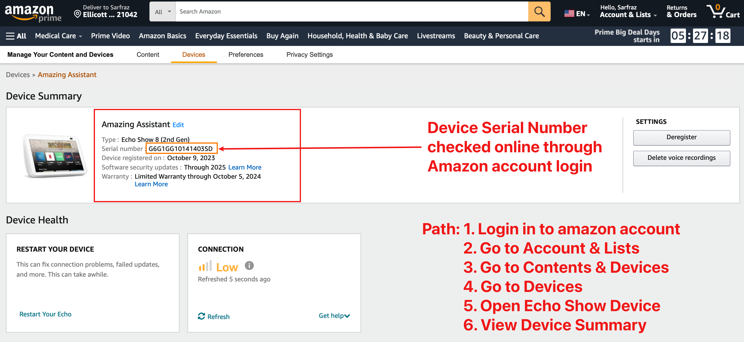
Verify Device Serial Number (DSN) Online

Slide 13
Data Storage on Device Cloud
The data storage on the Echo Show device, either on device or on the cloud, is a complex and unclear.
The voice commands are saved on the cloud
The operating system, user apps/skills, device settings, preferences, and other information are stored in the internal storage of the device.
The log files, temporary files and user data are are stored in the internal storage of the device and some of these are later deleted by the OS.

